Slide 1
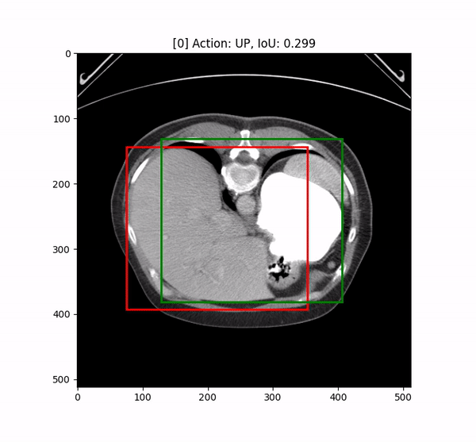
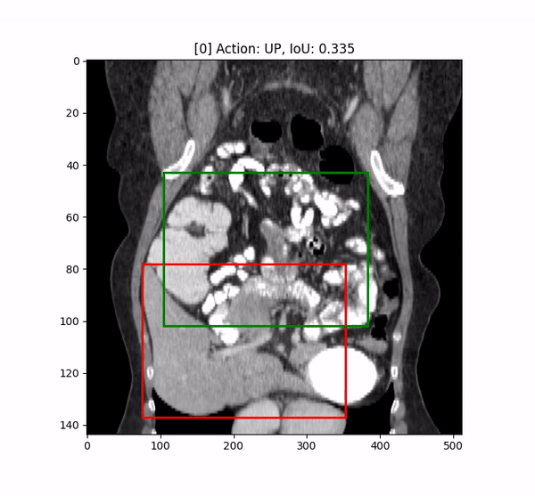
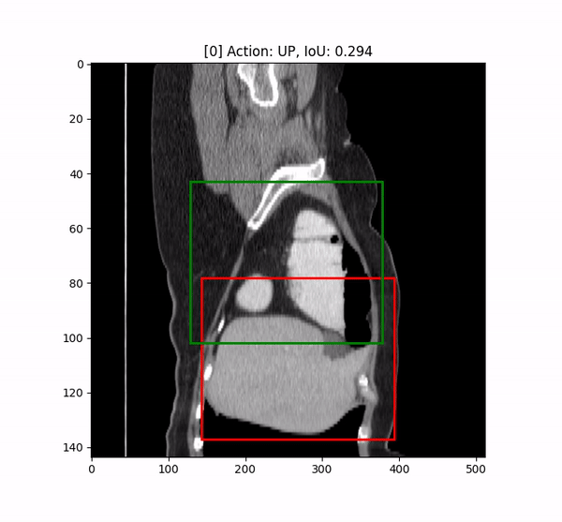
CT Organ Localization with Reinforcement Learning
Group Member: Kexin Yang, Hainan Xiong, Haoming Chen
Mentor: Alex Chowdhury

Slide 2
Background and Motivation
Identifying organ location in CT scans is an important but time-consuming task for many medical tasks such as disease diagnoses. So Deep Learning algorithm may be extremely helpful to improve radiologists’ working efficiency if it can accurately localize the organ of interests as a pre-processing step.
Problem:
Most of current SOTA model require large labelled datasets
Require the model to have relatively high accuracy before the model can be deployed in real-world situations

Slide 3
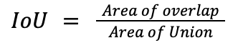
Project Goal
We want to design a reinforcement learning algorithm that can automatically localize specific organ(s) in CT images to improve the working efficiency of the disease diagnosis progress.
Baseline: a reinforcement learning-based organ localization model proposed by Navarro et al. (2020)
Goal: train the model with relatively small number of labeled data using RL-based model and try to improve the model performance
Evaluation Metrics: 3D IoU score (intersection over Union)

Slide 4
Dataset
We decided to use a publicly available Multi-Atlas Labeling CT Dataset. It contains 50 ab
domen CT scans randomly selected from a combination of ongoing colorectal cancer chemotherapy trials and a retrospective ventral hernia study. The 50 scans were captured during portal venous contrast phase with variable sizes:
Volume sizes: 512 x 512 x 85 - 512 x 512 x 198
Field of views: 280 x 280 x 280 mm3 - 500 x 500 x 650 mm3
In-plane resolution: 0.54 x 0.54 mm2 - 0.98 x 0.98 mm2
Slice thickness: 2.5 mm to 5.0 mm

Slide 5
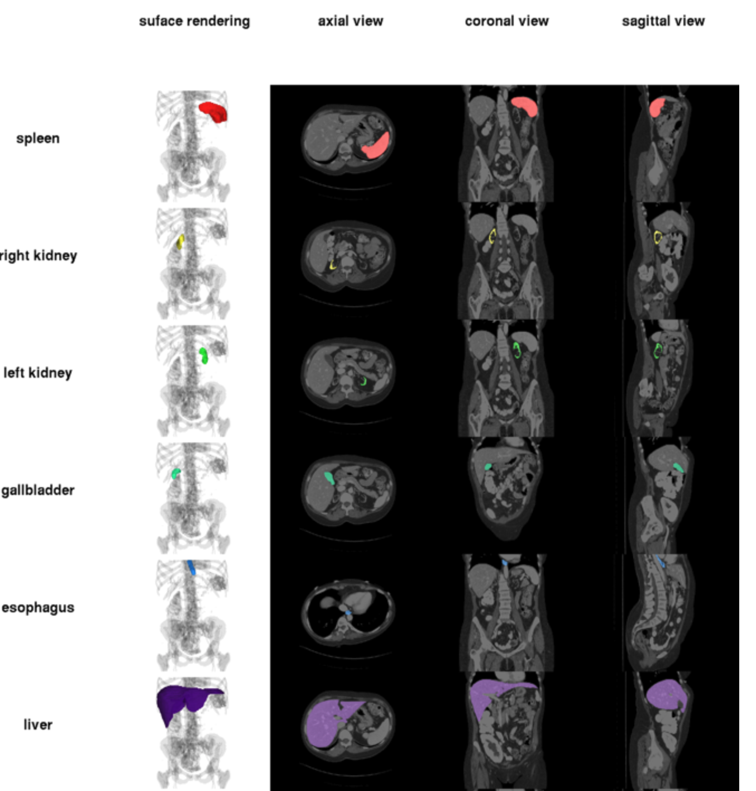
Dataset
We decided to use a publicly available Multi-Atlas Labeling CT Dataset, which contains 30 abdomen CT scans with labels of 13 different organs.
We splitted the dataset into 24 training samples + 6 testing samples
For this project, we will start with liver localization

Slide 6
Organ Labels
The label for the Dataset contains 13 abdominal organs that were manually labeled by two experienced undergraduate students and verified by a radiologist on a volumetric basis using the MIPAV software, including:
(1) spleen
(2) right kidney
(3) left kidney
(4) gallbladder
(5) esophagus
(6) liver
(7) stomach
(8) aorta
(9) inferior vena cava
(10) portal vein and splenic vein
(11) pancreas
(12) right adrenal gland
(13) left adrenal gland
For this project, we will start with liver localization

Slide 7
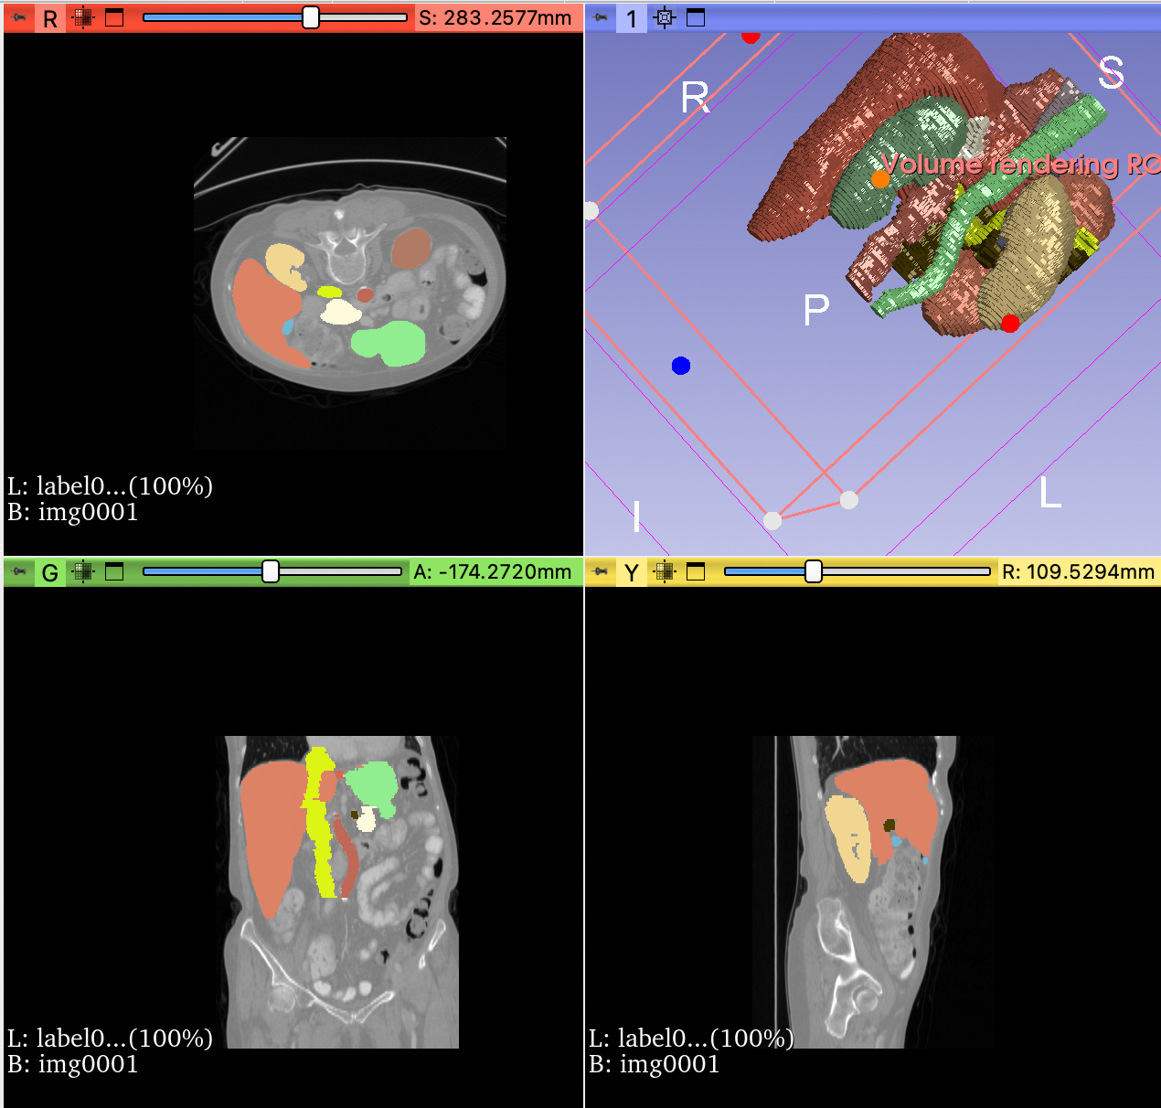
Dataset
Training Dataset: There are 30 total training data that each contains a 3-dimensional CT scan of the abdomen. A corresponding label is provided, which contains a 3-dimensional segmentation for multiple organs of interest.
Testing Dataset: There are 20 testing data, which also contains a 3-dimensional CT scan of the abdomen. No label is provided.
Limitation: One limitation would be the generalizability of our model performance in other datasets with varying CT scan volume and resolution. Even though our Dataset does contain some variability in terms of volume and resolution, it clearly doesn’t cover all possible ranges and therefore may not generalize to other Datasets.

Slide 8
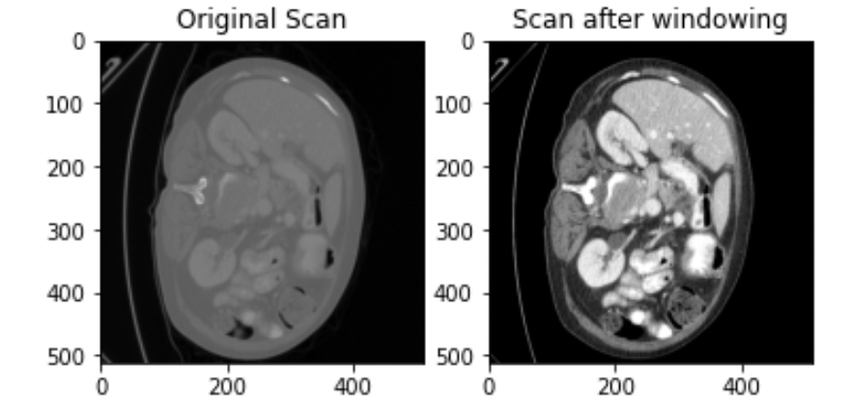
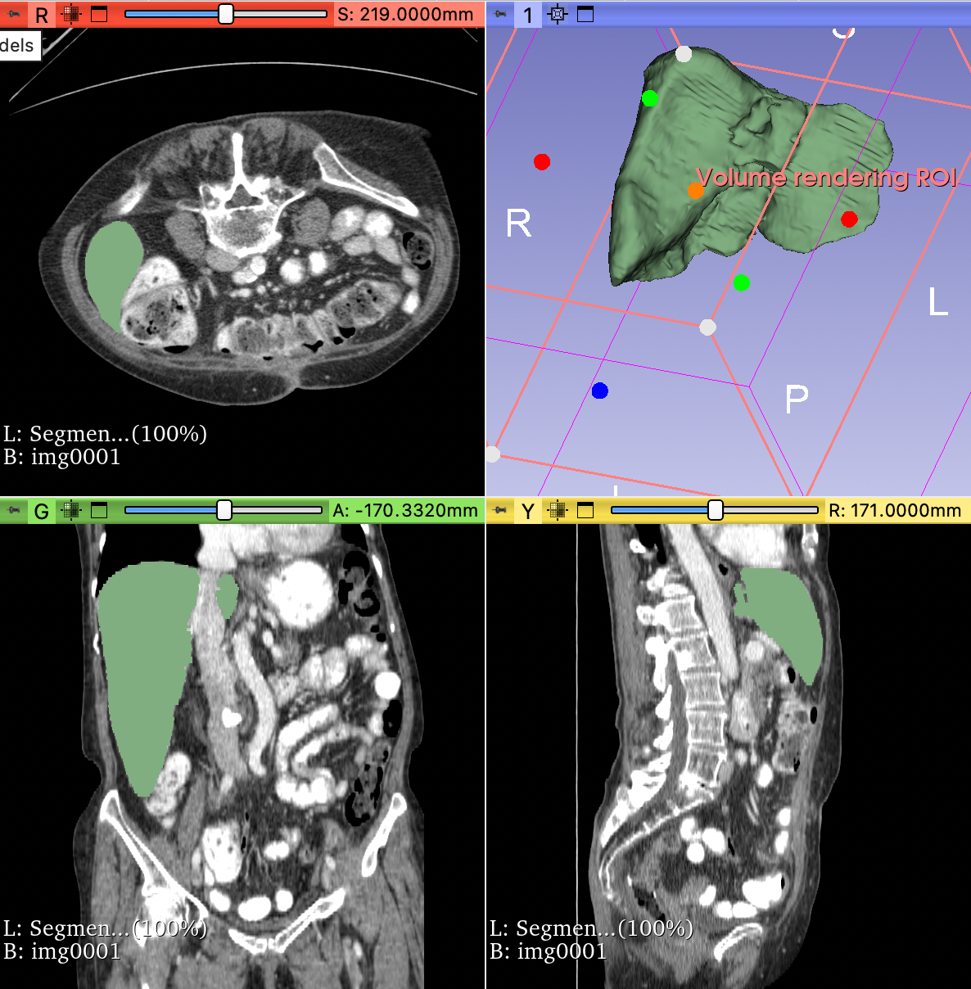
Data Pre-Processing
Step 1: CT Scan Windowing
Help highlight key anatomy so that the images can be analyzed easily.For our project, the ideal pixel range for abdomen region is -160 to 240.
Step 2: Select Target Label Class
Start with liver localization
Step 3: Bounding Box Label Generation

Slide 9
Data Pre-Processing
Step 1: CT Scan Windowing
The primary type of preprocessing used for CT scans is windowing, which helps highlight key anatomy so that the images can be analyzed easily. This is because certain organs will be most clear at certain pixel intensities due to certain characteristics such as their density. Therefore, we can choose an ideal pixel value range to highlight the organ of interest.
Ideal pixel range for abdomen region: -160 to 240
Window Center: 40
Window Width: 400

Slide 10
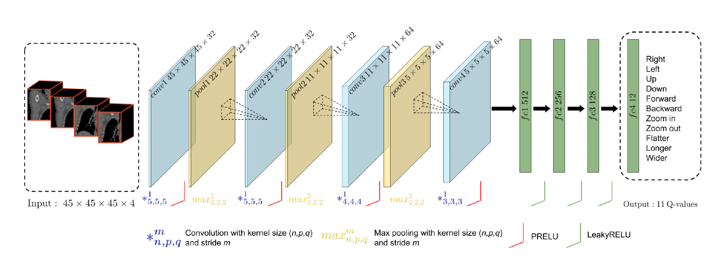
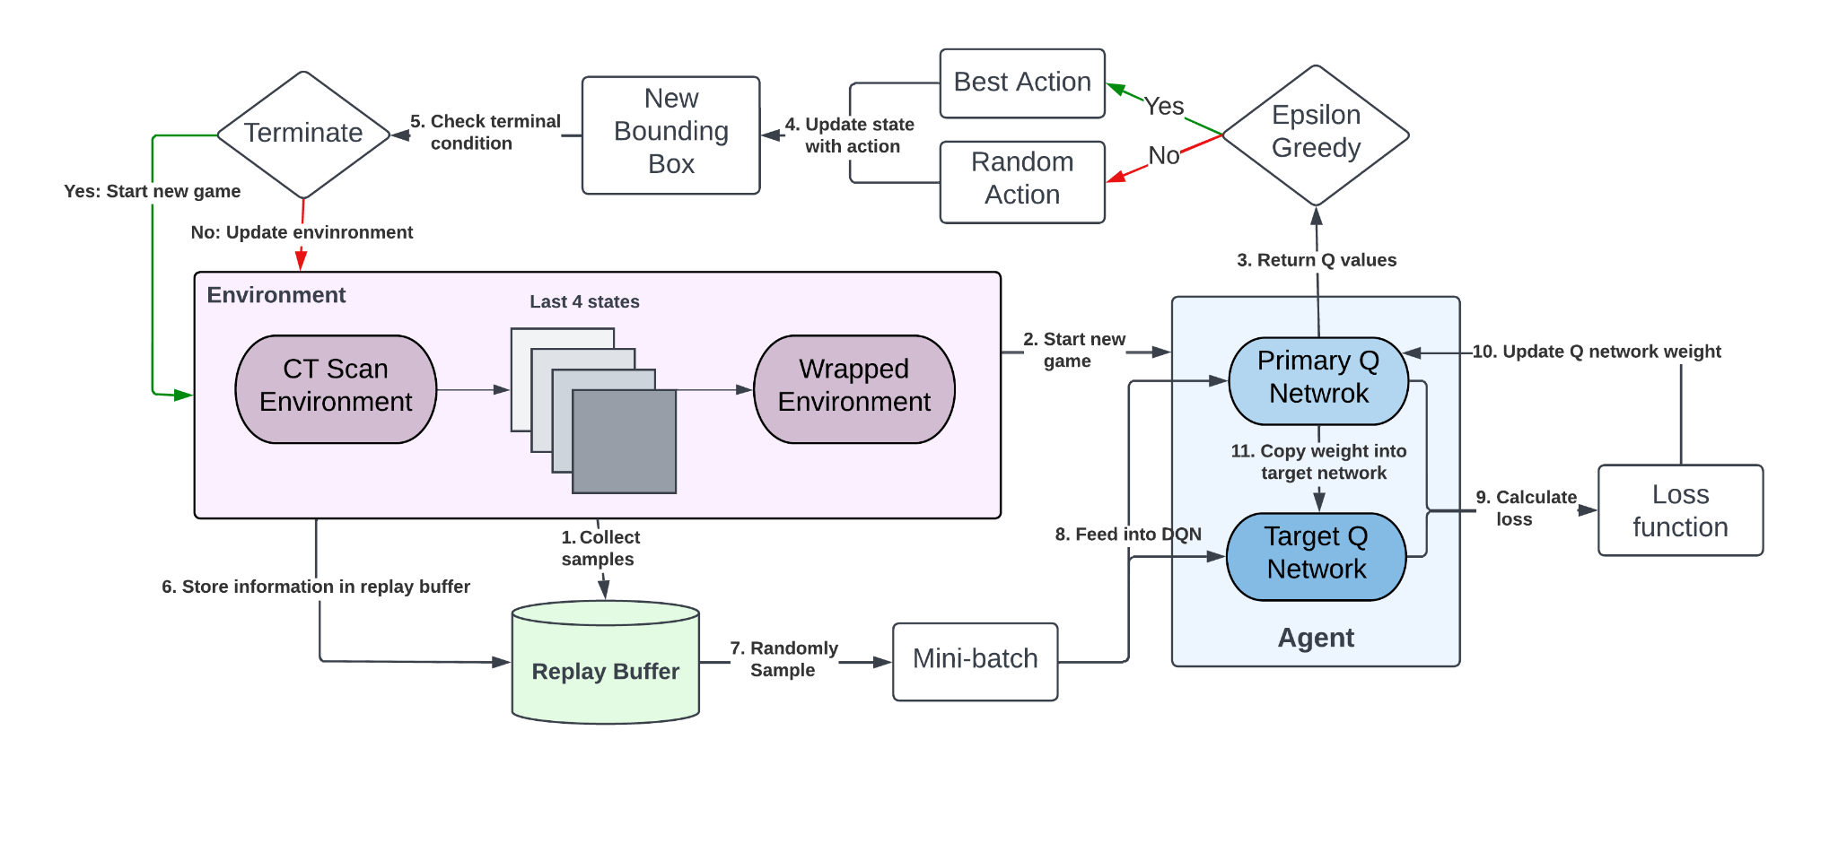
Model Framework
Dynamic terminate condition
New action update method
Network Architecture
Optimized rewards function
Double Q Network
Notes:
Briefly go through how RL framework works, and how we designed our model framework. Our model mainly consists of 3 part: an environment that contains the CT scan contents, an agent which will make decision on how to move the bounding box, and a replay buffer that contains the past game trajectory information such as bounding box coordinates and rewards.
To train the model, we will first collect samples to fill the replay buffer. Then, during each training iteration, a CT scan will be sampled from the training dataset and used as the environment for this game episode. The initial bounding box will be generated at the center of the scan. The scan contents inside the bounding box will be used to represent the current states, and we will feed the current plus the previous 3 states into the agent’s primary Q network to calculate the q values for these states. The agent follows an epsilon greedy policy to choose the action, where the value of epsilon is a hyperparameter that controls a probabilistic threshold of choosing a random action, otherwise, the calculated Q values will be used to choose the best action. The purpose of using this epsilon greedy policy is to allow some degree of exploration where the agents can try random action and see the results. A new bounding box coordinate will be calculated after performing the action, and this loop will be repeated until the terminate condition is reached. The new game trajectory will also be stored in the replay buffer, and after playing certain number of games, we will sample a mini-batch of trajectory from the replay buffer to calculate the loss and update the weight of the primary Q network.
We used a double Q network structure for the agent. We will not go into the detail of this structure, but one advantage of this structure is to allow more stable learning.
We proposed 3 main innovations based on the baseline model, which are highlighted in the red box.
where the loss function is calculated using the q values from both primary and target Q network, and the weight from primary q network will be copied into the target Q network every few hundred iteration.

Slide 11
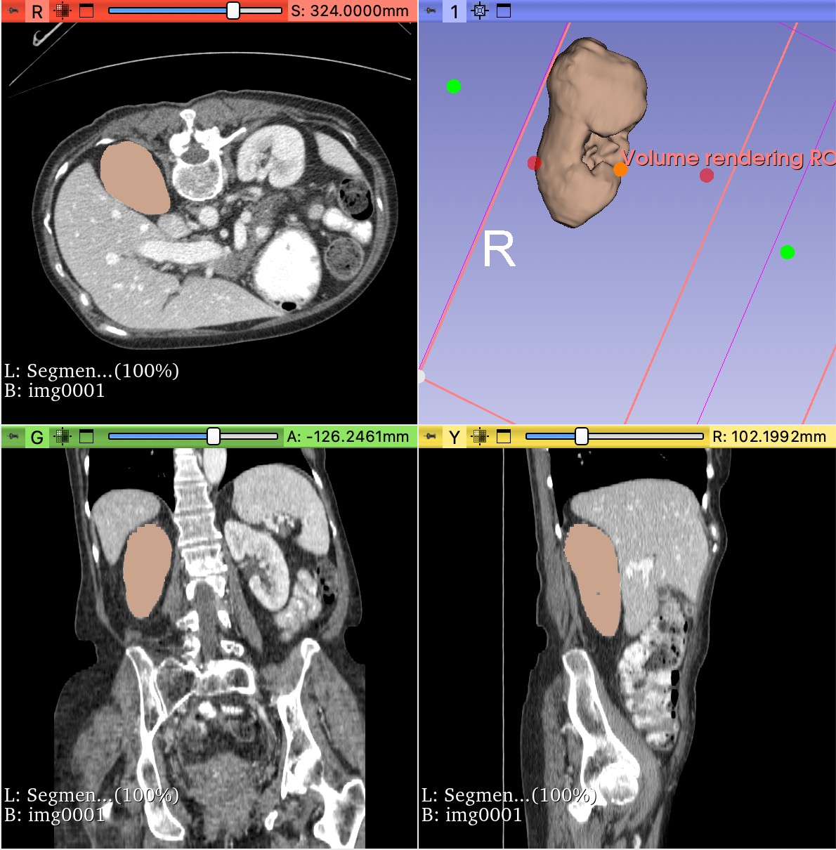
Data Pre-Processing
Step 2: Select Target Label Class
We will train each model to localize one single organ, so in the data pre-processing step, we will only extract label mask associated with the one organ. For our project, we will start with liver (label = 6), because the liver is typically the easiest to segment due to the large volume and usually a homogenous, ellipsoidal shape.
Step 3: Bounding Box Label Generation
The original organ label is provided as a segmentation mask, where the value indicates the type of organ (1 - 13). For our model, we will use the generate_spatial_bounding_box() function from monai.transforms.utils module to transform the segmentation mask into a bounding box that is represented by its upper-left-front coordinate (x, y, z), and lower-right-back coordinate (h, w, d).

Slide 12
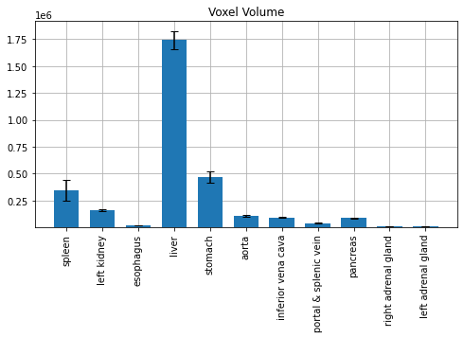
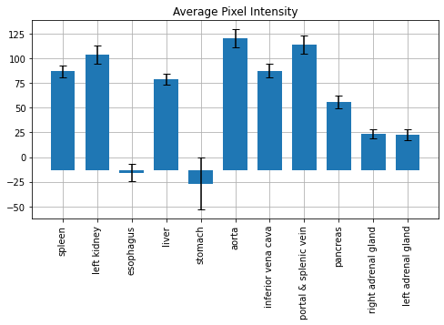
Exploratory Data Analysis
Since we do not need to generate any feature for our model, we simply plotted the voxel volume and average pixel density for different types of organ. The purpose was to choose which organ to start with, since we want to focus on one specific organ that is relatively easy to localize in order to quickly debug and tune our model.

Slide 13
Innovations
 | Baseline Model | Our Model
Rewards Function | Binary Rewards: -1, +1 | Proportional to change in IoU score Additional terminal rewards Penalty for out-of-boundary action
Terminal Condition | Oscillation occurrence Or reaches terminate IoU: fixed to be 0.85 | Max step size, increased with more training epochs: 15 to 20 Or reaches terminate IoU, increased with more training epochs: 0.60 to 0.85
Action Update Method | Proportional to bounding box length | Proportional to bounding box length Set minimum and maximum threshold Handle out-of-boundary cases
Notes:
This tables shows a comparison between the methods used in the baseline model, versus our proposed methods. We will dive into each points in detail in the next few slides.

Slide 14
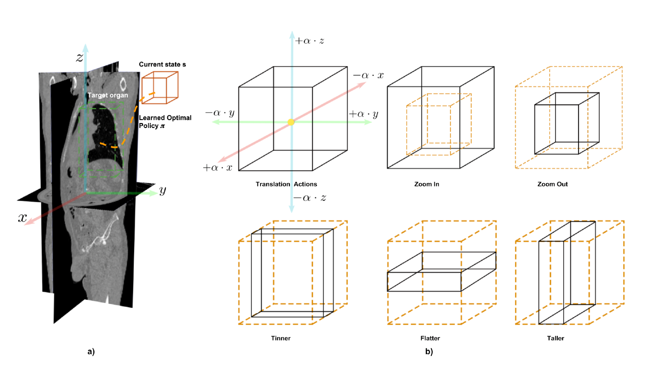
Model Framework - Environment & Agent
Environment: 3D CT scan
State: voxel values in the current bounding box
Action: 11 possible actions
6 Translation action
2 Scaling action
3 Deformation action
Update Method:
Step size: proportional to the size of the bounding box
Minimum step size: 1
Maximum step size: 10
Handle out of boundary case
Scaling action
Deformation Action
1. Start with some bounding box inside the CT scan
2. At each step, choose an action to move the bounding box, which ideally makes it closer to the true organ location
Notes:
The environment is the entire 3D CT scan, where as the current state is the voxel values in the bounding box.
As for the agent, at each step, it will “see” the current plus previous 3 states, and it need to choose an action to move the bounding box, ideally towards the true bounding box label. We provide 11 possible actions for the agent to choose from. The 6 translation action simply moves the bounding box in the 6 directions. The 2 scaling action allows the box to be zoom in or out, and the 3 deformation action makes the box to the thinner, flatter or taller.
How much the bounding box is changed is decided by the step size. The baseline model simply set the step size to be proportional the the size of the bounding box, i.e, it will always be 10% percent of its current size. For our model, we also set a minimum and maximum range to prevent the box from getting too big or too small. We can pay special attention to handle the case when the bounding box exceeds the CT scan boundary.

Slide 15
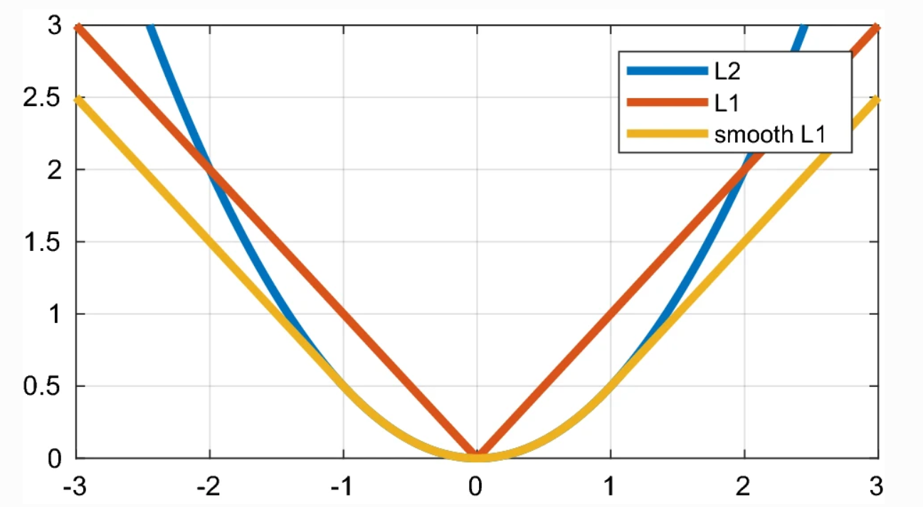
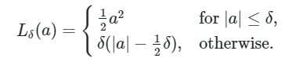
Model Framework - Rewards & Loss
Optimized Rewards Function
The baseline model uses a simple binary rewards to indicate increased vs. decreased IoU score.
Reward is calculated as the difference between current and previous IoU times a scaling factor to reflect the degree of improvement
Give additional rewards if terminal condition is reached within max step size
Give penalty if the new bounding box exceeds the boundary
Loss
Smooth L1 Loss: A combination of L1 and L2 loss
Notes:
The rewards function is also very important for the performance of an RL model. The baseline model uses a simple binary rewards to indicate increased vs. decreased IoU score. This will make it very difficult for the model from learning the optimal trajectory towards the organ’s true location since it cannot distinguish an average versus very good action.
So in our model, we calculated the rewards as the IoU between predicted and true bounding box to reflect the degree of improvement
We also give additional rewards if terminal condition is reached within max step size, and we assign a penalty if the new bounding box exceeds the boundary
For the loss function, we used smooth L1 loss, which is a combination of L1 and L2 loss. The figure on the slides shows a comparison between these 3 loss functions.

Slide 16
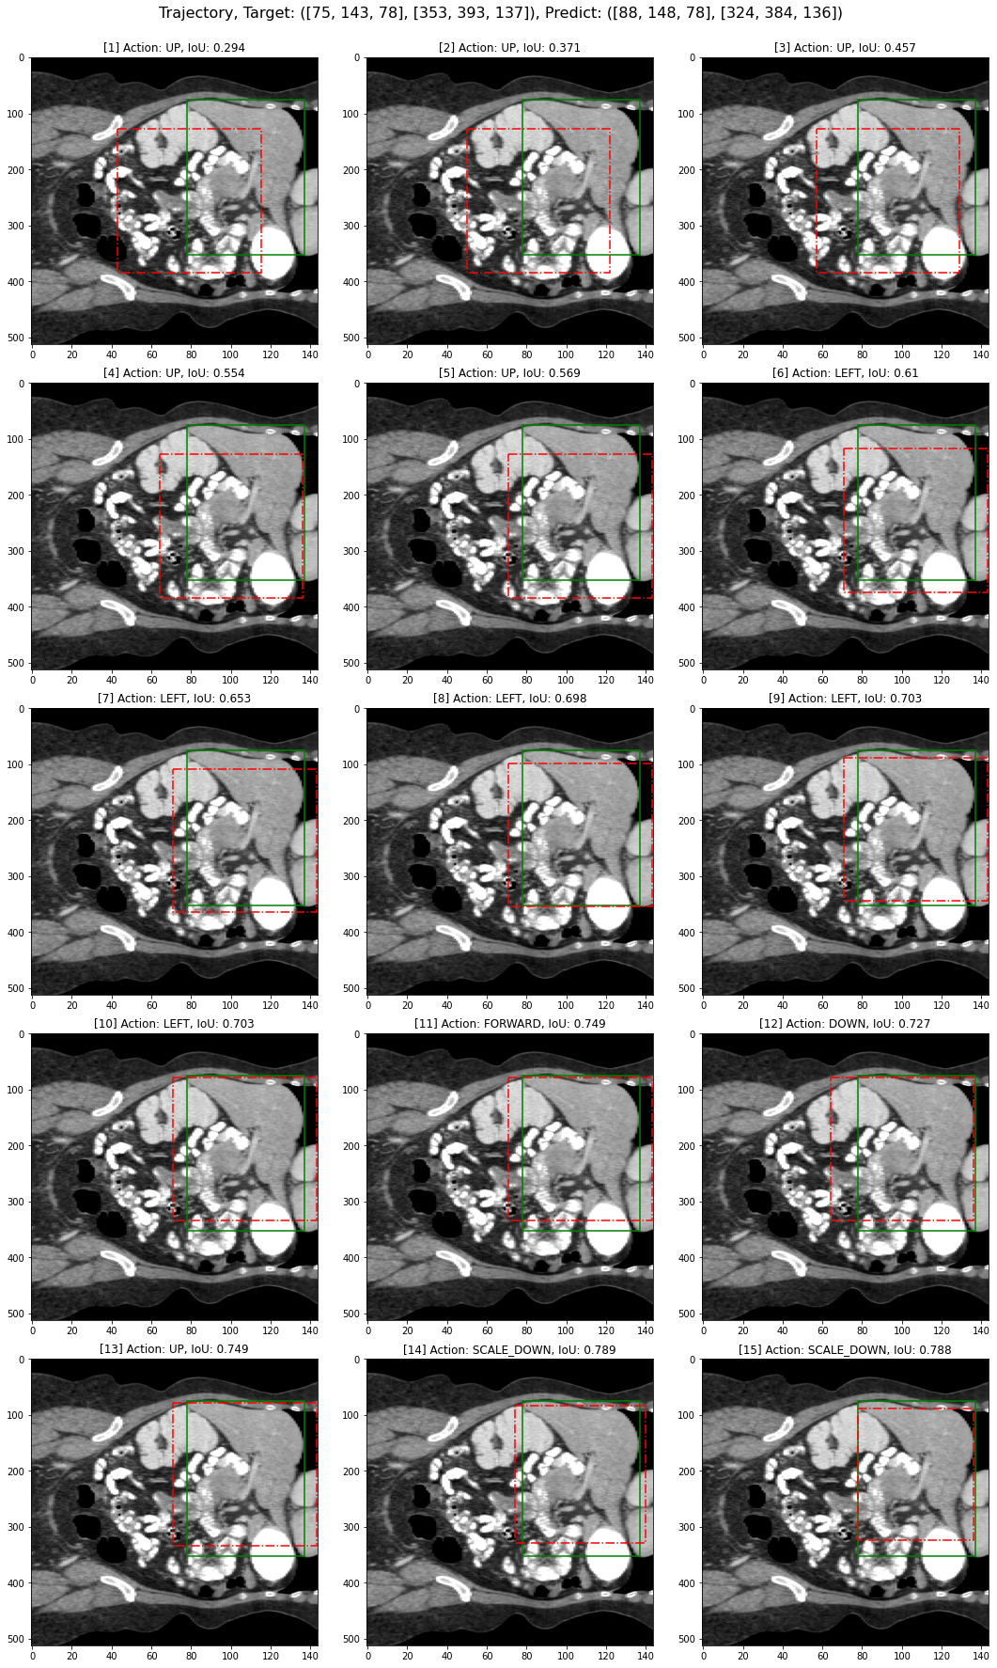
Example - Rewards Calculation
True Bounding Box Label
Model Predicted Bounding Box
State 0
Initial IoU: 0.554
Terminal IoU: 0.80
Step size: 10% x box length
State 1
Action: move up
Terminal: False
Out of boundary: True
New IoU: 0.569
Rewards: (0.569 - 0.554) x 100 - 10 = 5
State 2
Action: move left
Terminal: False
Out of boundary: False
New IoU: 0.610
Rewards: (0.610 - 0.569) x 100 = 41
Notes:
This slides show an example of how the bounding box is updated and how the reward is calculated. Here the green box shows the true bounding box and the red box shows the bounding box predicted by the model.
So in this example, the terminal IoU is set to be 0.8, and the initial IoU score is 0.55, and the step size is set to be 0.1 times the box length. The agent looks at the current states, and decides to move up, so the new bounding box is moved upwards by 10% of its box height. The new IoU is 0.569, and since here the new box is out of boundary, and penalty is added, and the rewards for this action is calculated as the IoU score difference times a scaling factor, minus the penalty 5.
For the next step, the agents decides move left, and this time the bounding box did not exceed the boundary again, so the reward for this step will be 41. This way, the model will be able to distinguish that moving left is a better action than moving up even though they both increase the IoU score.

Slide 17
Example - Game Trajectory
Axial View
Coronal View
Sagittal View
Notes:
This animations show the entire trajectory of our agent from 3 different views. We can see here that the initial Bounding box is generated at the center of the scan, that covers 50% of the scan width and heights, then it moves closer to the target locations. For the terminate condition, the baseline model checks for occurrence of oscillation, in our model, we set instead the max step to be 15. And the corresponding IOU score improved from 0.2 - 0.78. The corresponding action is also shown on the top.

Slide 18
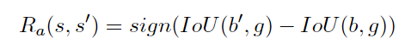
Baseline Model - Environment & Agent
Environment: the 3D CT scan
State: voxel values in the current bounding box
Action: 11 possible actions
Translation: x+, x-, y+, y-, z+, z-
Scale: s+, s-
Deformation: dx (thinner), dy (flatter), dz (taller)
Reward:

Slide 19
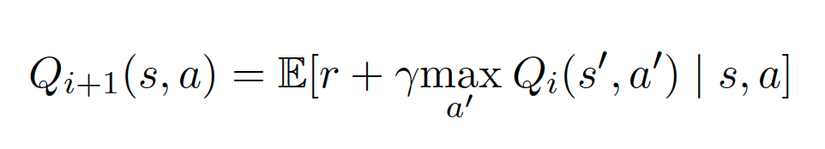
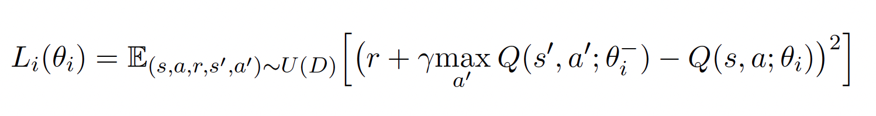
Model Framework - Deep-Q Learning

Slide 20
Baseline Model - Replay Buffer
One of the main advantage of using RL-based model is its ability to achieve good performance with limited labeled Dataset. This is largely due to the use of replay buffer.
Stores trajectories of experiences that interact with the environment when executing a policy
Sample these trajectory during training (possible in batch) to learn and optimize the agent’s policy
Agents can interact with the same environment (labeled sample) many times and generate different trajectories form which it can learn

Slide 21
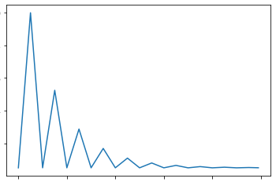
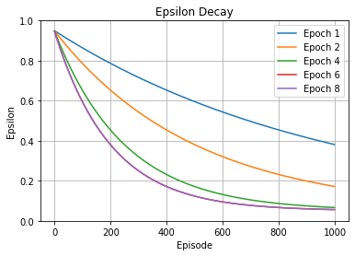
Training Config
Epsilon: controls the probability of random action vs. best action
Exponential decay to transition from exploration to exploitation
Accelerate the decay to allow for more exploitation as the model gets more training
Optimizer:
AdamW
Learning Rate Scheduler:
Cyclic Annealing
 | Baseline | Our Model
Training Data Size | 70 | 24
Training Epochs | 30 | 8
Batch Size | 48 | 8
Replay Buffer Size | 14,000 | 1,000
Notes:
We use AdamW as optimizer, and schedule the learning rate with Cyclic annealing. The plot in the center shows the value of the learning rate during training. This lr scheduler can help us avoid stucking at the local minimum
The table shows a comparison of some training configuration between the baseline and our mode. Noticed that our dataset is much smaller than the baseline. Also, constrainted by the Computational resources and memory space, we are only able to use a smaller batch size and less training epochs for the current model.
Epsilon controls the how to choose between random action and greedy action
Usually, we will start with a large epsilon in each epoch, which means more random actions to explore the environment
And then gradually decrease to a small number, which c
Vary decay rate of epsilon in the epsilon exponential decay.
Early epoch: small decay rate, focus more on exploration
Later epoch: large exploitation, most samples are generated from greedy action

Slide 22
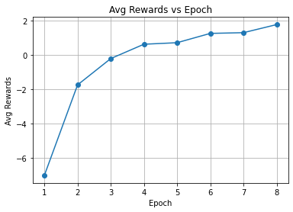
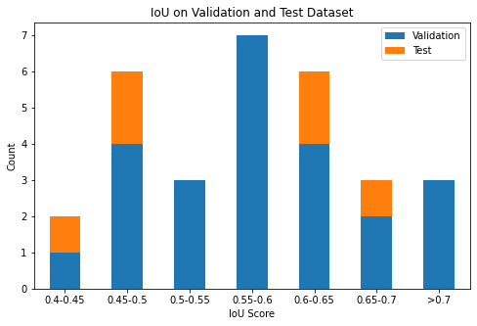
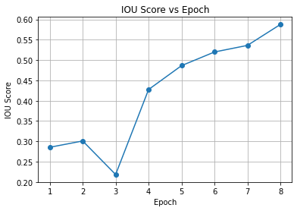
Model Performance
Baseline Test IoU (30 epochs): 0.80
Our Model Validation IoU (8 epochs): 0.59
Our Model Test IoU (8 epochs): 0.56
Generalize well to test dataset
We expect the model performance to continue increasing with more training since the IoU score and rewards is clearly not converging after 8 epochs of training.
Notes:
There is a Gap between our model performance with baseline model performance, however, this may be simply results from less training.
Therefore, to better understand the potential of our model, we plot the trend of avg rewards and IOU score over epochs. These two score is clearly not converging and we expect them to keep increasing with more training. Currently the our best sample already achieves 0.8 IoU score, so we think it is reasonable to believe that our model can also reach or even exceeds the 0.8 baseline with more training and hyperparameter tuning.
We also Visualize the distribution of IOU between validation and test -> generalability
IOU score fall within the range 0.4 - 0.7

Slide 23
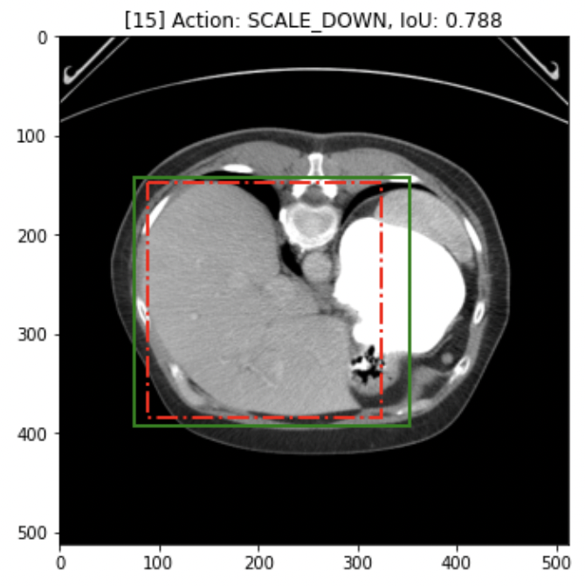
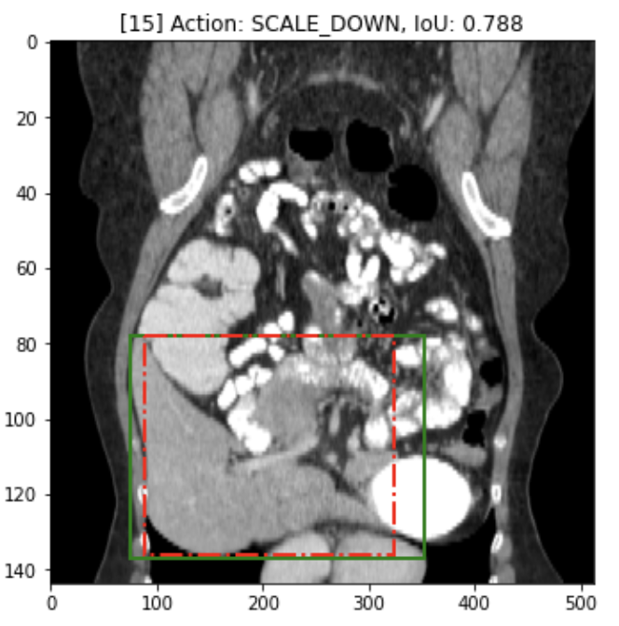
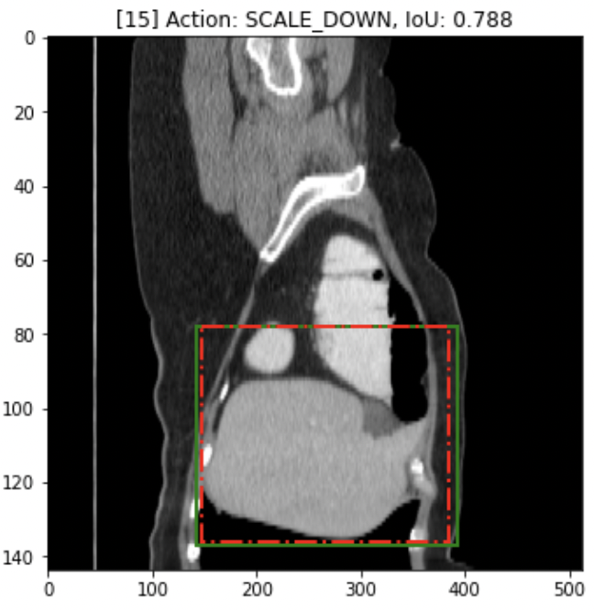
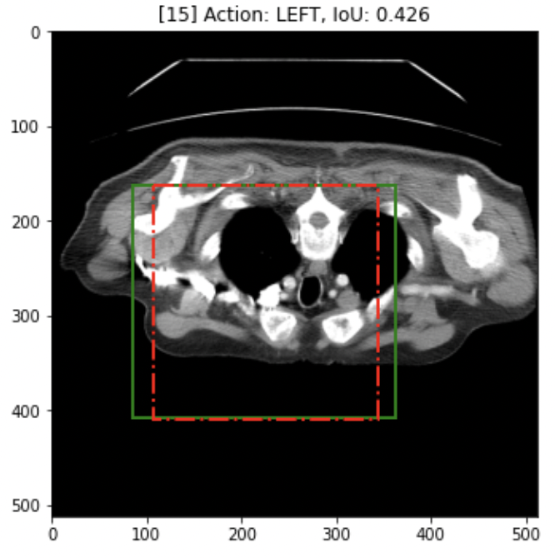
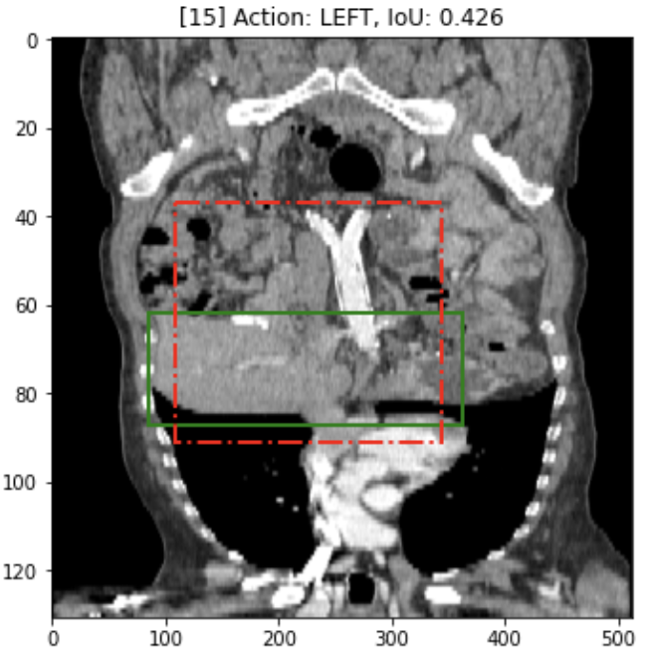
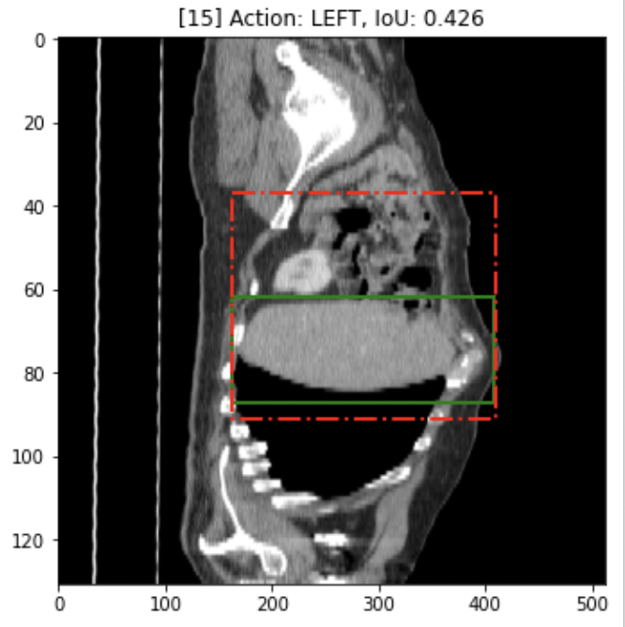
Example Bounding Box Prediction
True Bounding Box Label
Model Predicted Bounding Box
Best Example
Image 21
IoU Score: 0.79
Worst Example
Image 15
IoU Score: 0.426
Notes:
We dive deeper into concrete examples to better understand our model’s strength and weakness and guide us to improve the model. Here we Pick one example with highest IOU score and one example with the lowest IOU score to understand in which scenarios our model can make good prediction.
In our implementation, we place the Bounding box, same width and height, at the center of the image
Good example: target bounding box has a similar shape as our initial bounding box, thshift along direction
Bad example: more challenging, need deformation -> more steps

Slide 24
a)
b)
Notes:
We dive deeper into concrete examples to better understand our model’s strength and weakness and guide us to improve the model. Here we Pick one example with highest IOU score and one example with the lowest IOU score to understand in which scenarios our model can make good prediction.
In our implementation, we place the Bounding box, same width and height, at the center of the image
Good example: target bounding box has a similar shape as our initial bounding box, thshift along direction
Bad example: more challenging, need deformation -> more steps

Slide 25
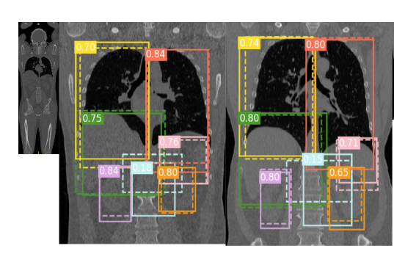
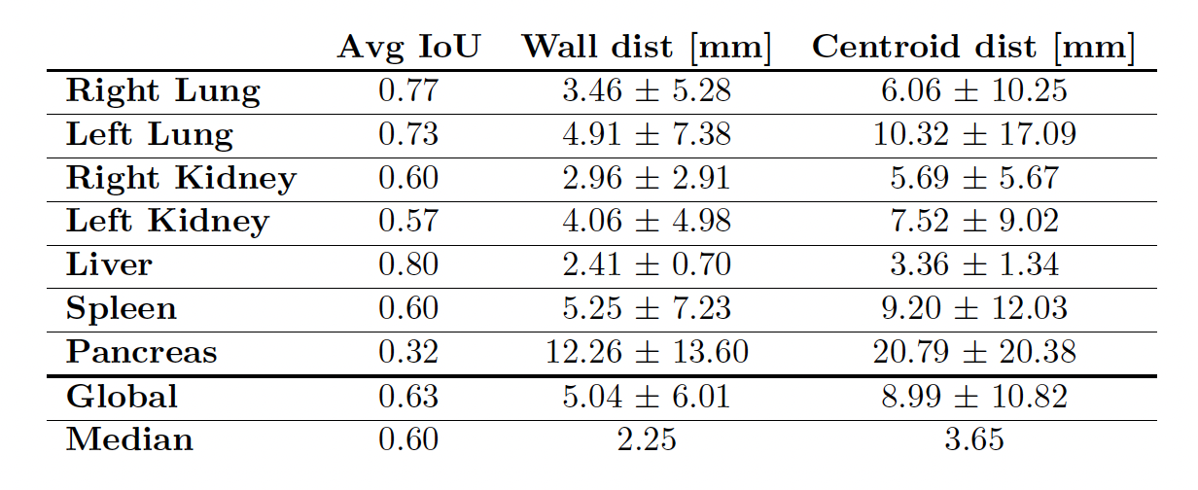
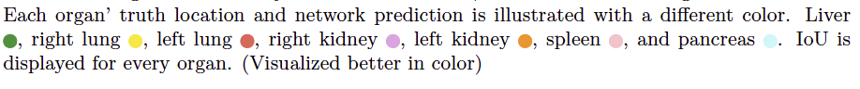
Baseline Model Performance - Original Paper
Notes:
Shows baseline model performance on other organs. We can see that while the baseline achieves a high IoU on liver localization, the performance for some of the other organs is not very good, for instance, pancreas only has 0.32 IoU score. This means that there are definitely room for improvement.

Slide 26
Limitation & Future Direction
Limitation
Limited training epoch and hyperparameter tuning due to restricted computation resource
One limitation would be the generalizability of our model performance in other datasets with varying CT scan volume and resolution. Even though our Dataset does contain some variability in terms of volume and resolution, it clearly doesn’t cover all possible ranges and therefore may not generalize to other Datasets.
Future Direction
Train the model on more organ localization tasks using larger datasets to test for its generalizability.
If the model can achieve high organ localization across different organs on large datasets, it may be possible to deploy this model in hospitals as a part of the CT scan pre-processing pipeline.

Slide 27
